Slide 1


Interactive Atmospheric Composition Emulation for Next-Generation Earth System Models
Mohammad H. Erfani^{1,3}, Kara D. Lamb², Susanne E. Bauer³, Kostas Tsigaridis^{1,3}, Marcus van Lier-Walqui^{1,3}, and Gavin Schmidt³
¹Center for Climate Systems Research, Columbia University
²Department of Earth and Environmental Engineering, Columbia University
³NASA Goddard Institute for Space Studies
Notes:
Hello, my name is Mohammad, and today on behalf of our research group, I will present our work entitled “Interactive Atmospheric Composition Emulation for Next-Generation Earth System Models”

Slide 2
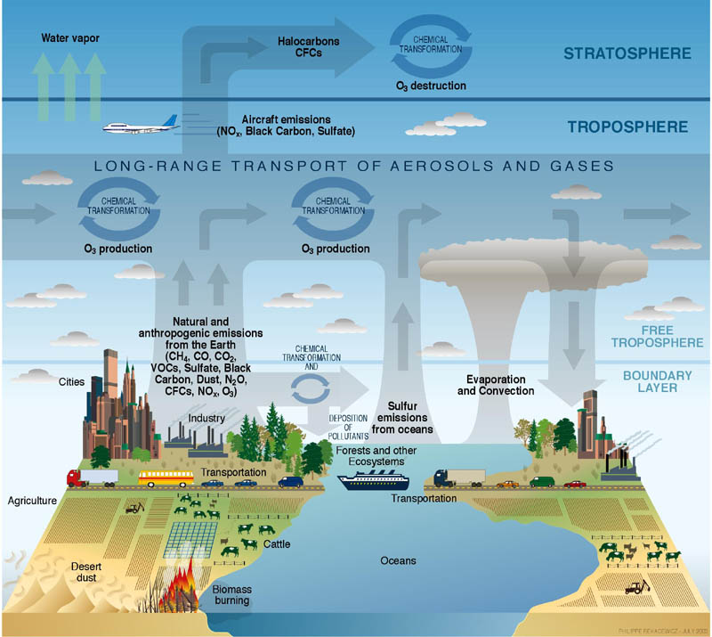
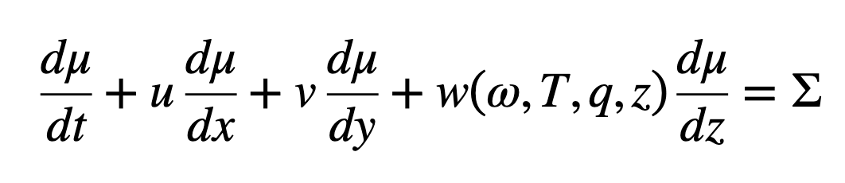
Define the problem
NASA GISS ESMs (ModelE)
Atmospheric Composition Module
Atmospheric Transport Model
Horizontal Advection
Vertical Convection
Sink/Source
terms
Benson, V., Bastos, A., Reimers, C., Winkler, A.J., Yang, F. and Reichstein, M., 2025. Atmospheric transport modeling of CO2 with neural networks. Journal of Advances in Modeling Earth Systems, 17(2), p.e2024MS004655.
Image credit: Susanne E. Bauer
2
Notes:
In this project we are supposed to surrogate the atmospheric transport component of GISS Earth System Model (ModelE).
On the left you can see the schematic showing all the contributors for atmospheric composition in this ESM
To accurately emulate atmospheric transport, the ML model should learn to capture key spatial dynamics. This involves modeling horizontal advection and vertical convection.

Slide 3
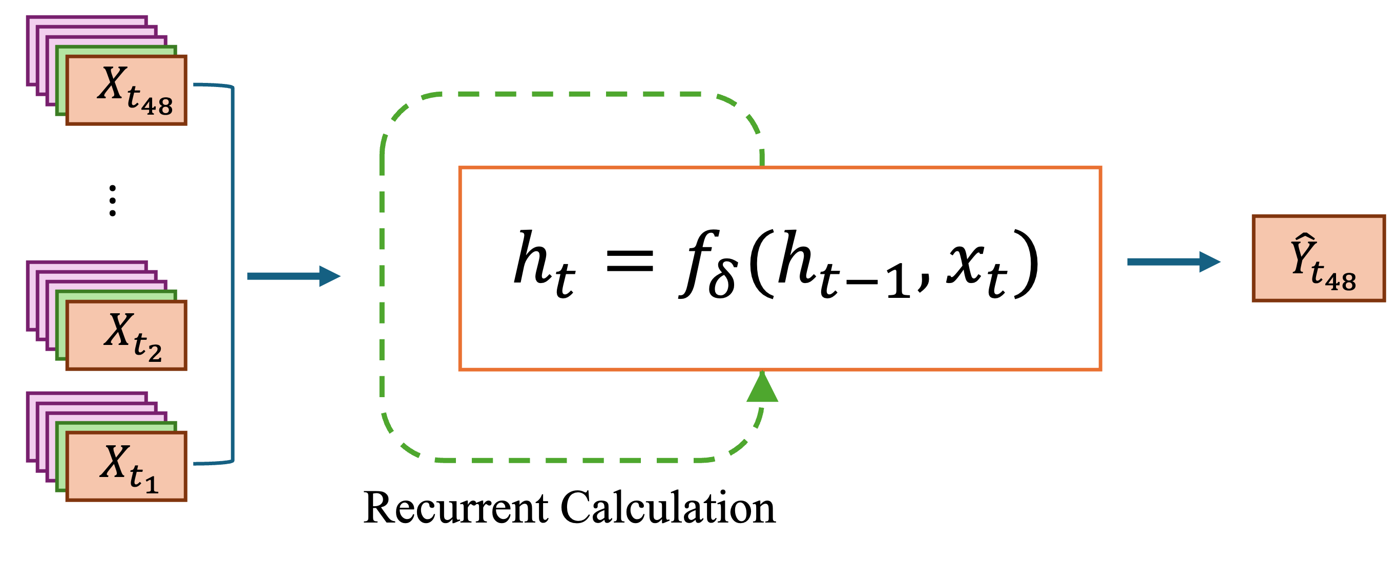
Model Conceptualization Spatio-temporal Machine Learning
Sequence of Input Variables
Target Variable at Desired Timestep
Recurrent Calculation
Notes:
For such a task, autoregressive rollout approach, is a common practice, but we decide to adopt spatiotemporal approach, as they consider a specific mechanism for capturing temporal dependencies, which is crucial for stable performance of the model over the long-term climate projections.

Slide 4
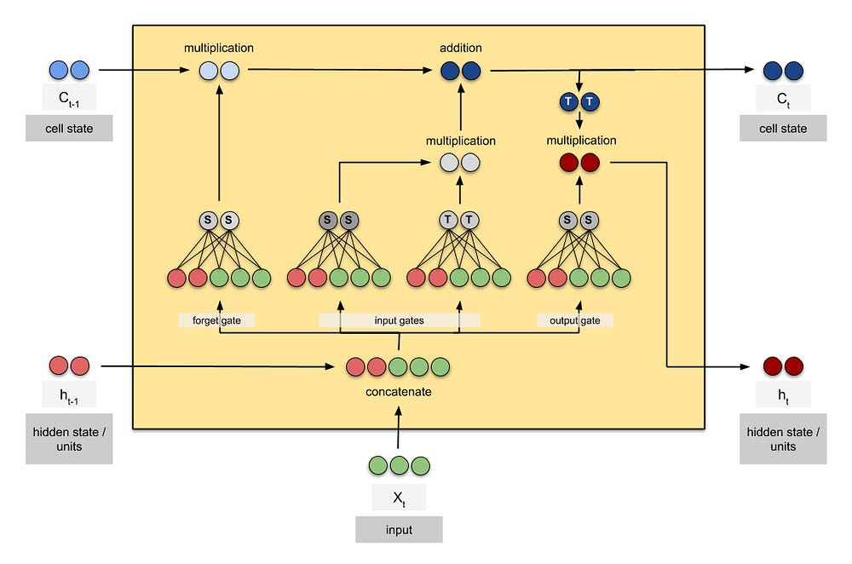
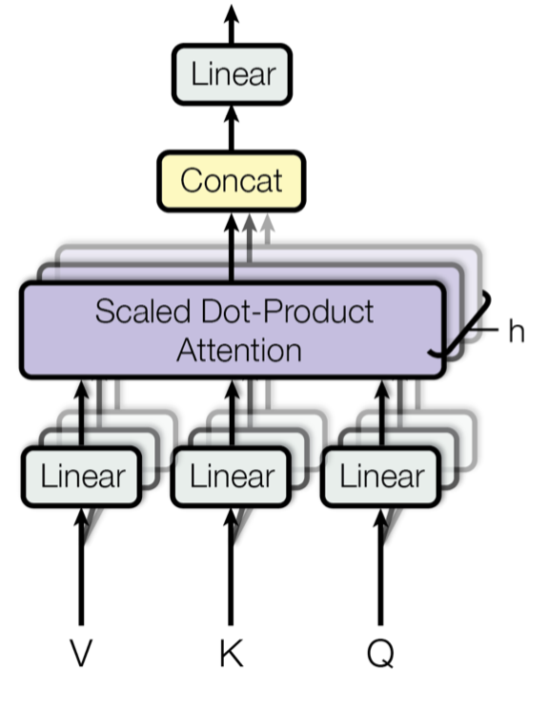
Capture Temporal Dependencies Short-term Patterns / Long-term Trends
Long short-term memory (LSTM)
Attention Mechanism
Notes:
And it’s really regardless of what type of temporal module we want to use,
we just need to include this mechanism to be able to capture both short-term patterns and longer-term trends

Slide 5


Model Architecture Profile-Guided Fusion Module (PGFM)
X2D: B×T×6×1×H×W
X3D: B×T×8×L×H×W
Input
(B×T)×(6×1)×H×W
(B×T)×(8×L)×H×W
2D Spatial Encoder
2×(5×5 conv, 64)
3D Spatial Encoder
2×(5×5 conv, 64)
(B×T)×F₁×H×W
(B×T)×F₂×H×W
SFT
$$ℳ(F_{2}|F_{1})$$
Gao, Zhangyang, et al. "Simvp: Simpler yet better video prediction." Proceedings of the IEEE/CVF conference on computer vision and pattern recognition. 2022.
Tan, Cheng, et al. "Temporal attention unit: Towards efficient spatiotemporal predictive learning." Proceedings of the IEEE/CVF Conference on Computer Vision and Pattern Recognition. 2023.
Wang, Xintao, et al. "Recovering realistic texture in image super-resolution by deep spatial feature transform." Proceedings of the IEEE conference on computer vision and pattern recognition. 2018.
B×T×F_{M}×H×W
ConvLSTM
3×64
B×1×F×H×W
Readout Layer
(1×1 conv)
$\hat{Y}$: B×1×L×H×W
Notes:
We also introduced Profile-guided fusion module to properly account for the column physics, and capture the complex multi-level interactions and dependencies. This module receives 2D and 3D data as two separate modalities and fused them via Spatial Feature Transform operator.
The output of PGFM can be fed into any type of spatio-temporal model

Slide 6
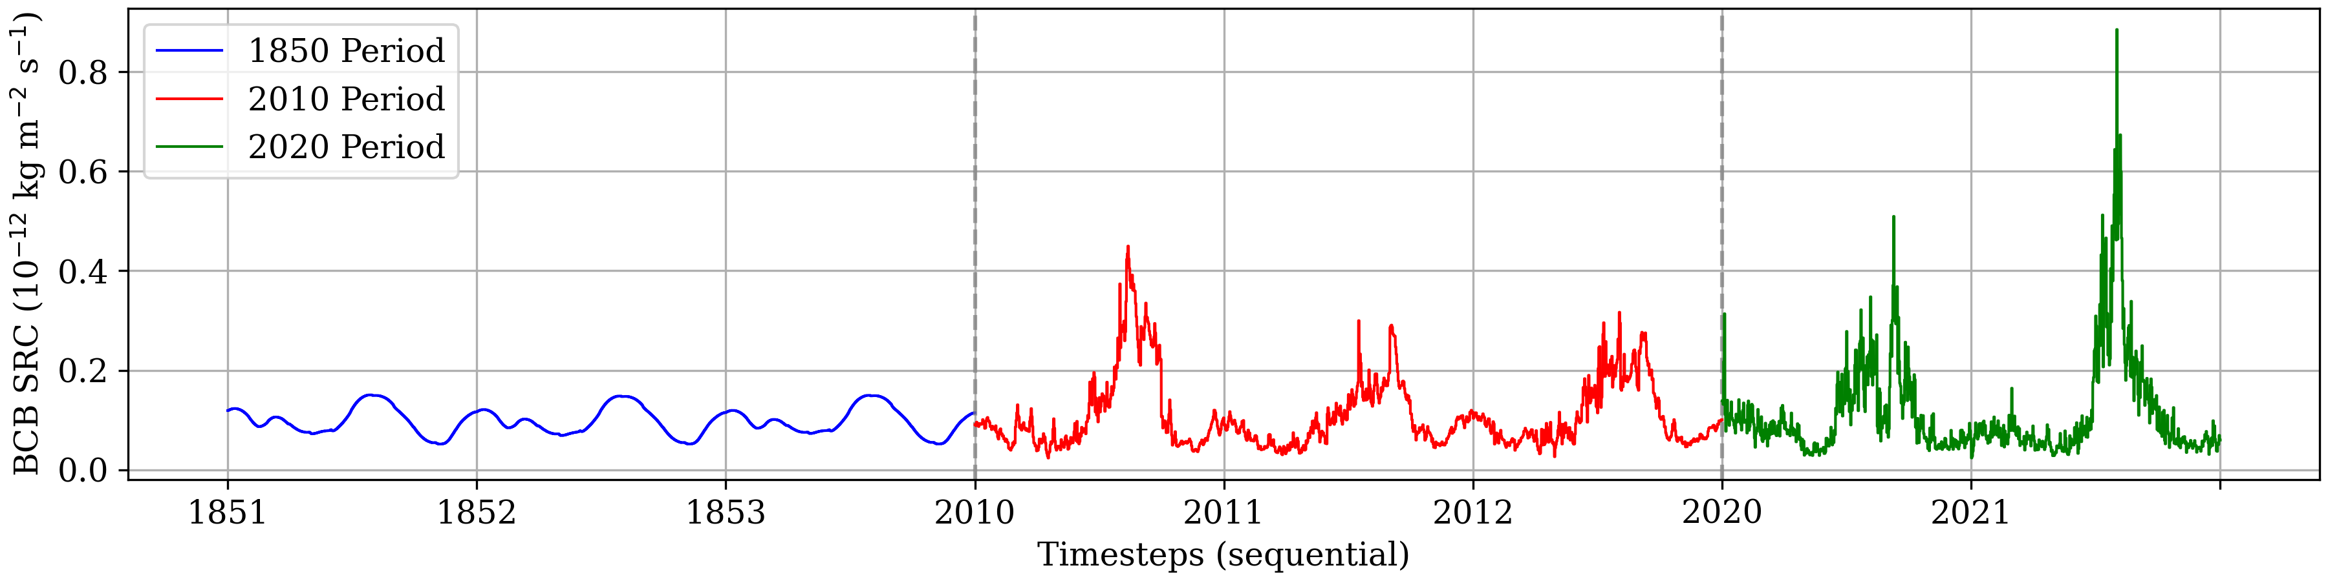
BCB Emission Sources Global Daily average
Notes:
The dataset includes eight years of data with the half and hour resolution. This figure shows the emission of black carbon from biomass burning over these 8 years.
The orange parts are designated for train set and the magenta parts for test.

Slide 7
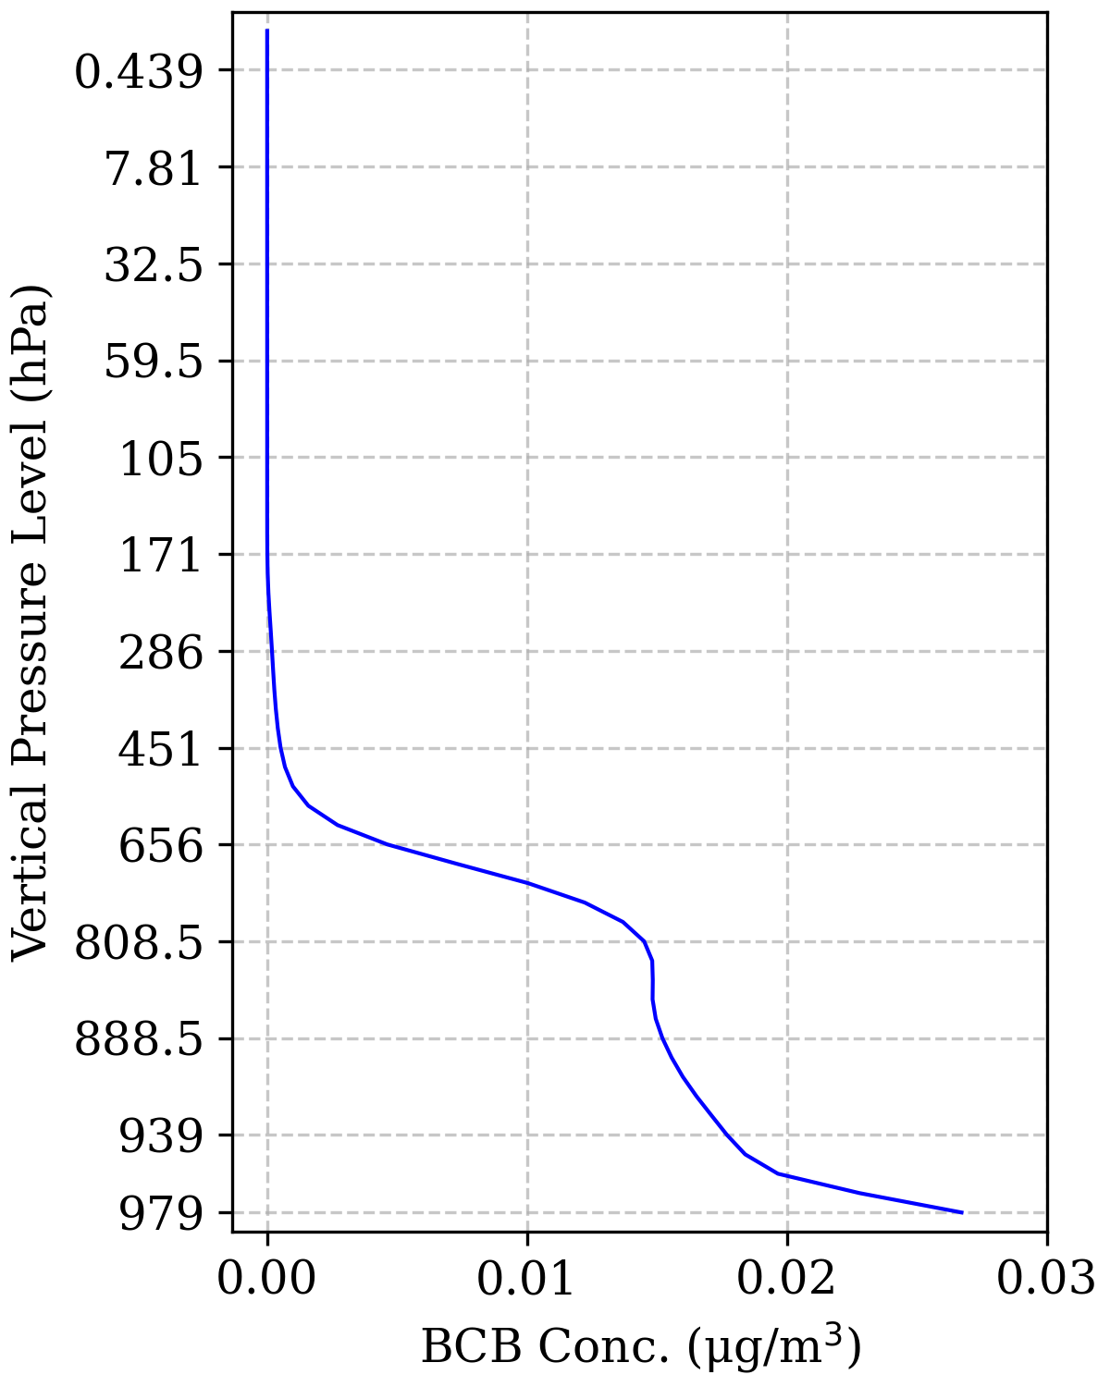
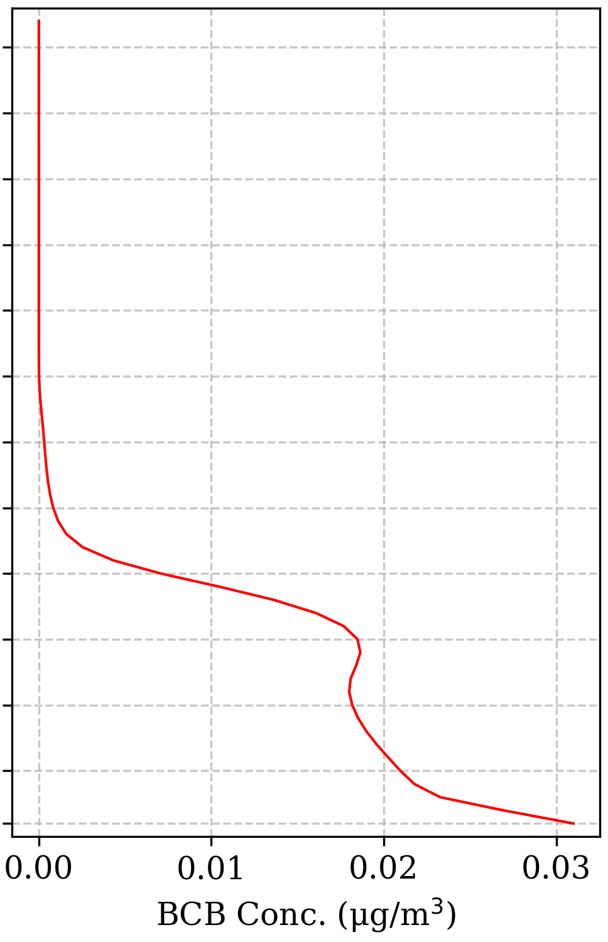
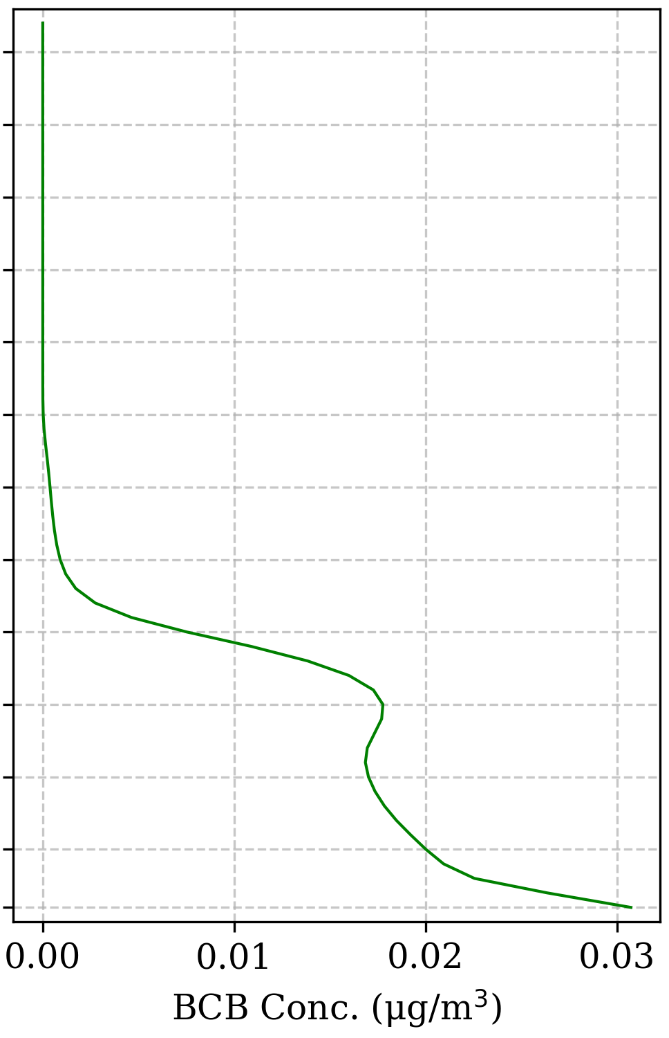
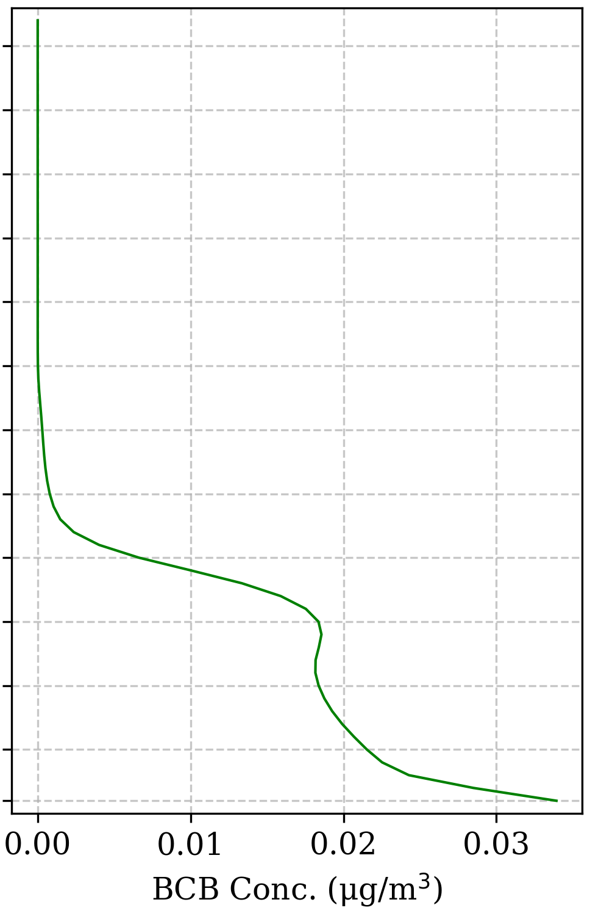
Vertical profiles of BCB Conc. 62 Atmospheric Levels
(a) 1853
(b) 2012
(c) 2020
(d) 2021
Notes:
In this study we calculate the bcb concetration up until the pressure level that falls into troposphere.
However, given the fact that BCB concentration drop significantly after 656, we just include first 20 levels.

Slide 8
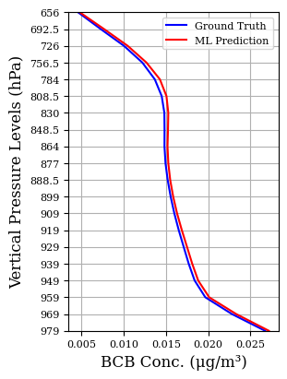
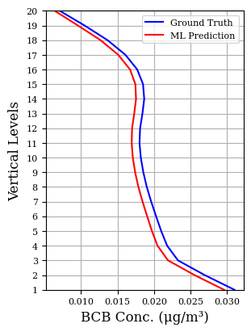
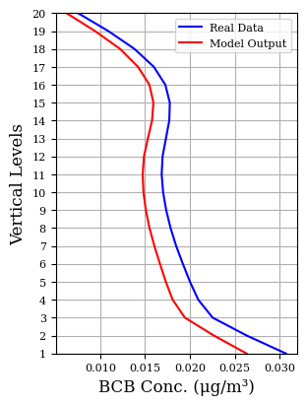

Vertical profiles of BCB Conc. 20 Atmospheric Levels
(a) 1853
(b) 2012
(c) 2020
(d) 2021
Notes:
These figures show the results and compare BCB concentration profiles across 20 vertical levels for ML output versus ground truth data.
The profiles show the model ability to capture the vertical distribution pattern with a small marginal bias for different time periods.

Slide 9
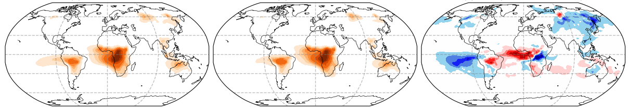
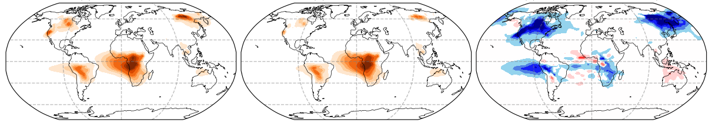
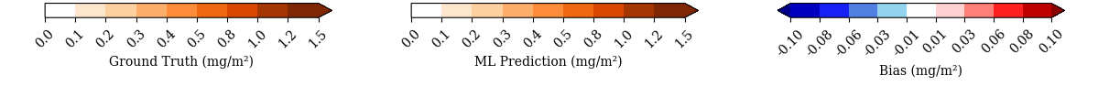
BCB Column Burden Annual Average
2012
2021
Notes:
This figure show Annual mean for BCB column burden.
The left column is the ground truth from ModelE simulations. The middle column is the machine learning predictions, and the third column represents the bias (prediction - ground truth)
Results show for active areas the ML model generally have underestimation.

Slide 10
Conclusion
Architectural provisions
Temporal evolution
Vertical atmospheric coupling
Climate modeling
Stable performance over long-term projection
Preprint: https://arxiv.org/abs/2510.10654
Notes:
Our findings confirm our central hypothesis that “architectural provisions” for temporal evolution and vertical atmospheric coupling result in model accuracy and physical consistency.
This is important especially in the case of climate modeling, where we need stable model performance for a long-term projections.

Slide 11
LSTM Short-term Patterns / Long-term Trends

Slide 12
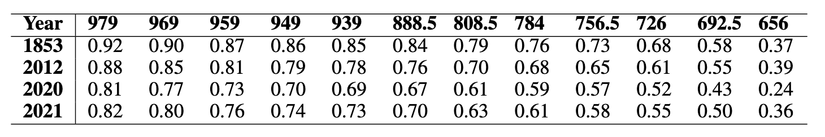
Model Performance R² Comparison across Different Pressure Levels
L01→L05
L10
L15
L16→L20

